Slide 1
Class D Audio Amplifier
Daniel Raymond

Slide 2
What is a Class D Audio Amp?
There are many classes of audio amplifiers that all have different operating processes
Class D amps use two switches that are either fully on or fully off to modulate a digital signal
That digital signal is then turned back into an analog audio signal
Notes:
Speak on how its more powerful and energy efficient

Slide 3
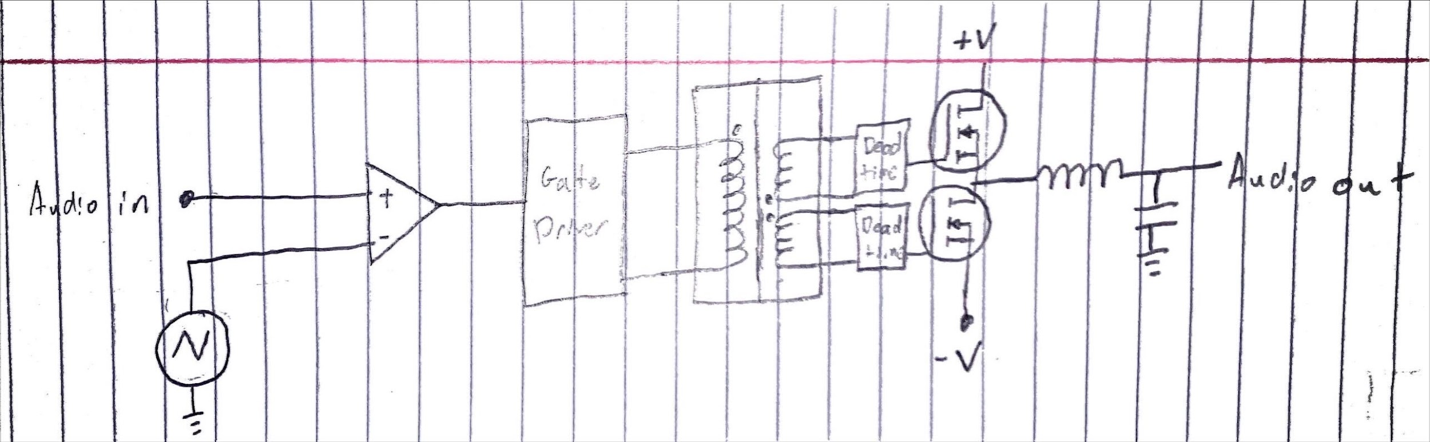
Circuit Functional Block Diagram
Transistor driver
Comparator
Output filter
Power transistors
There are four main parts: comparator, transistor driver, power transistors, and output filter

Slide 4
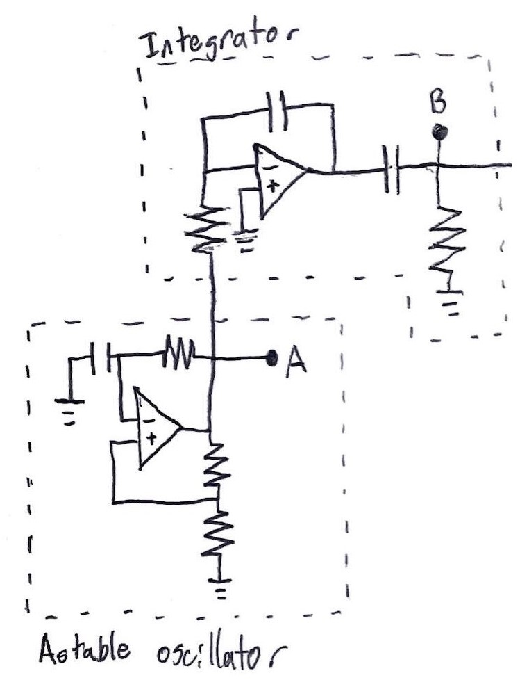
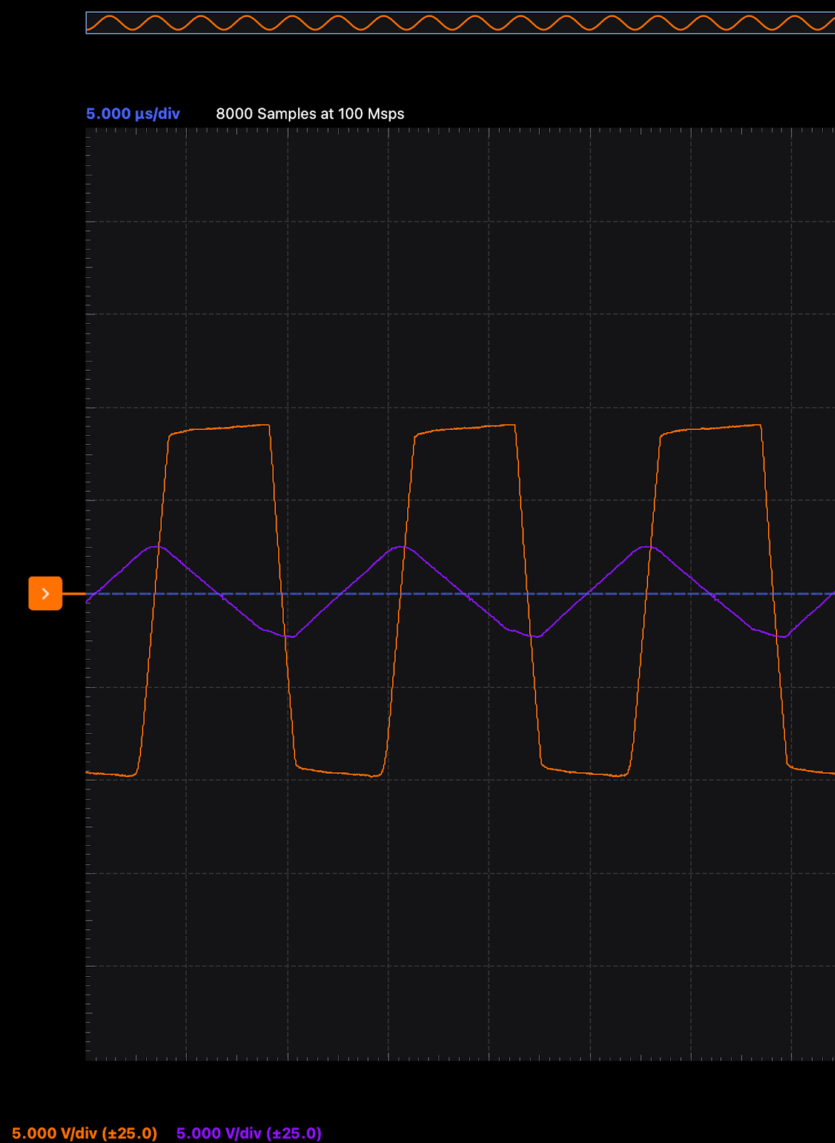
Schematic Part 1
The astable oscillator uses the charging characteristics of a capacitor to time a square wave
The integrator uses the physics equation I=dQ/dt rearranged to Q=Idt to output a waveform that is the integral of the input waveform
A B

Slide 5
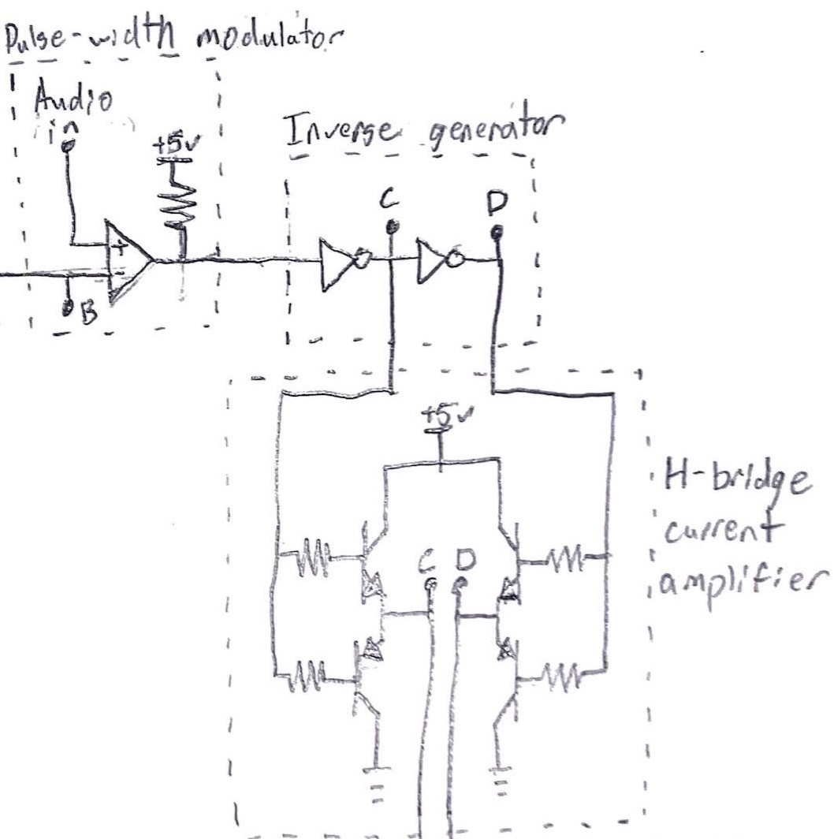
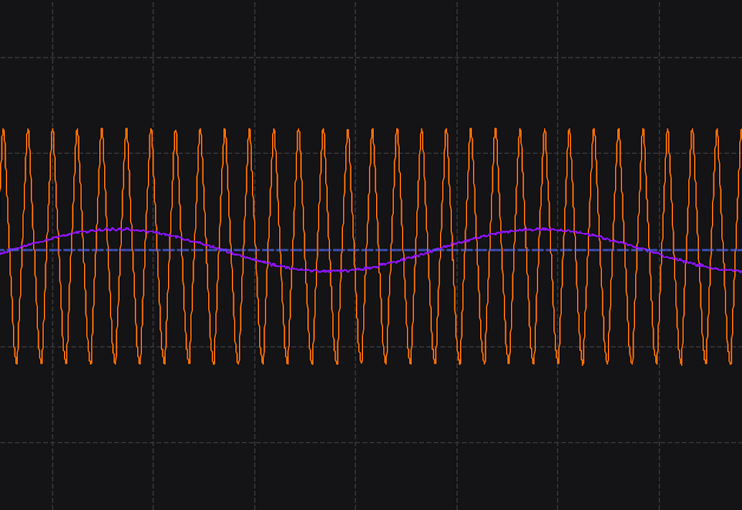
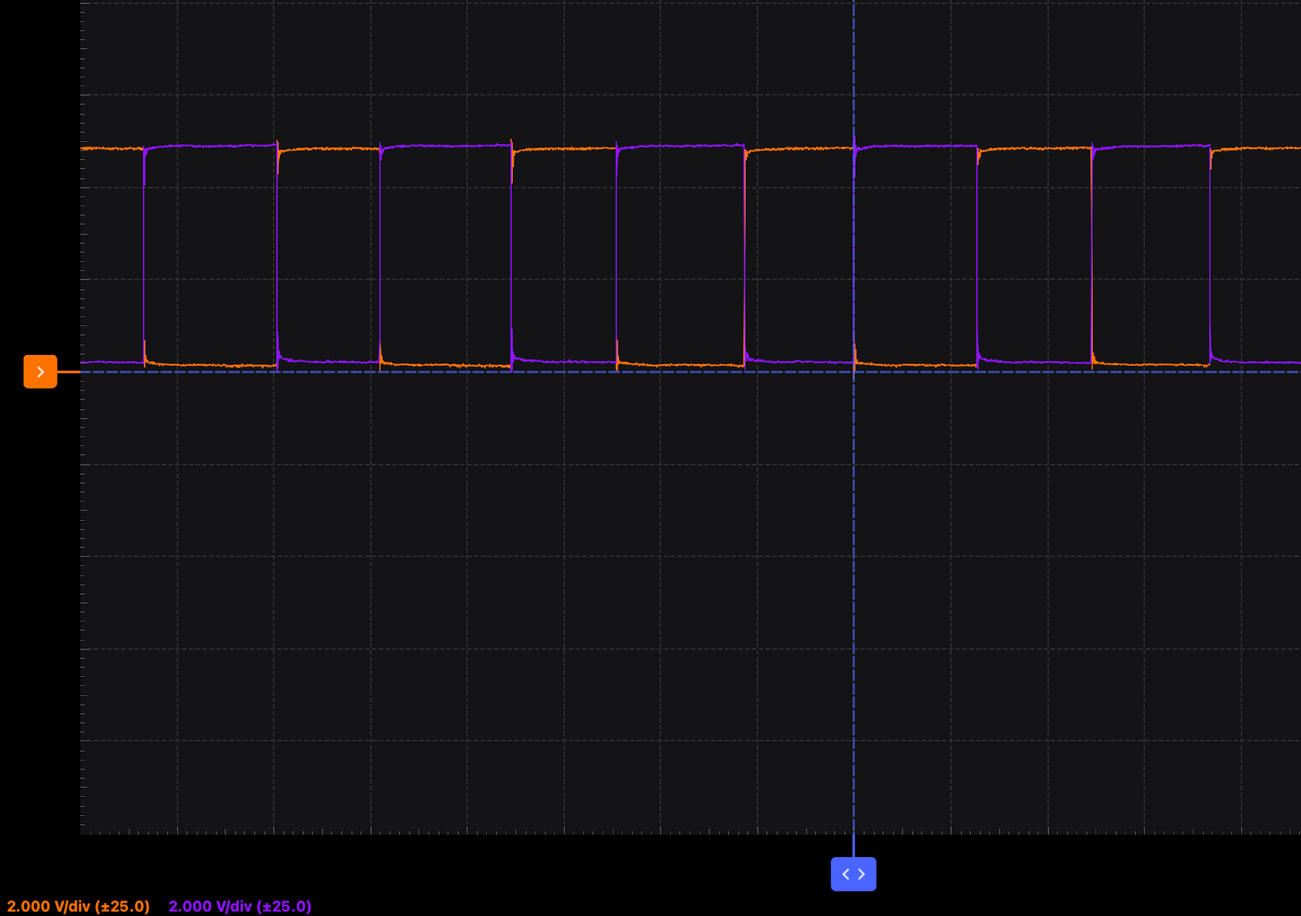
Schematic Part 2
The central comparator turns the audio into a variable pulse width signal by comparing it to a triangle wave. The higher the “audio in” voltage, the longer the square wave spends at the positive voltage.
The inverse generator and current amplifier don’t change the waveform
The higher current and inverse waveform are important for the next step
B Audio in
C D

Slide 6
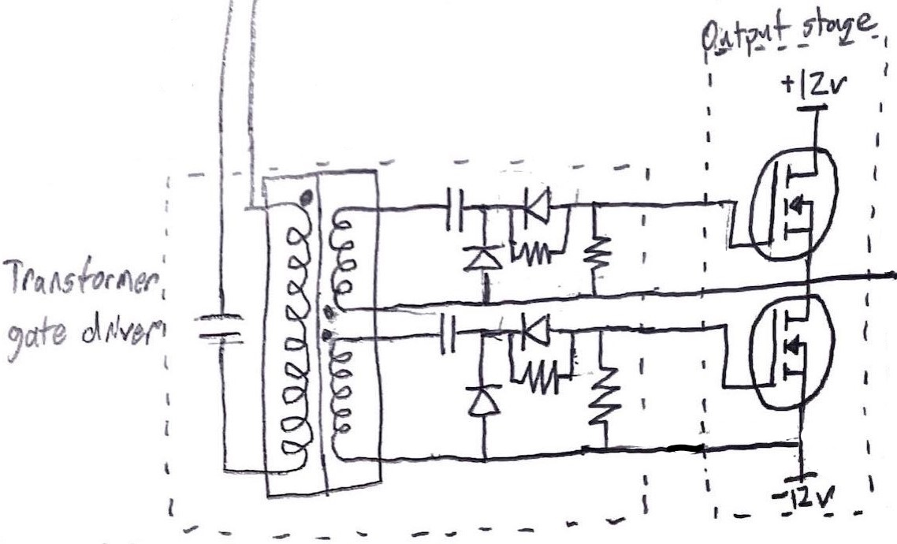
Schematic Part 3
The main power field effect transistors (FETs) in the output stage handle all the output current for the amplified signal
The transformer creates isolation needed to drive two transistors that are at different voltage levels
There is some added deadtime circuitry that prevents overlap in the on time for the transistors

Slide 7
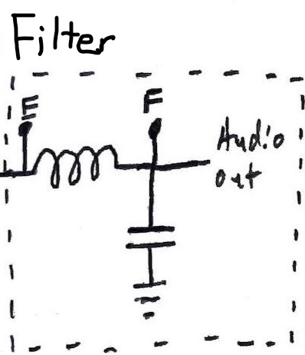
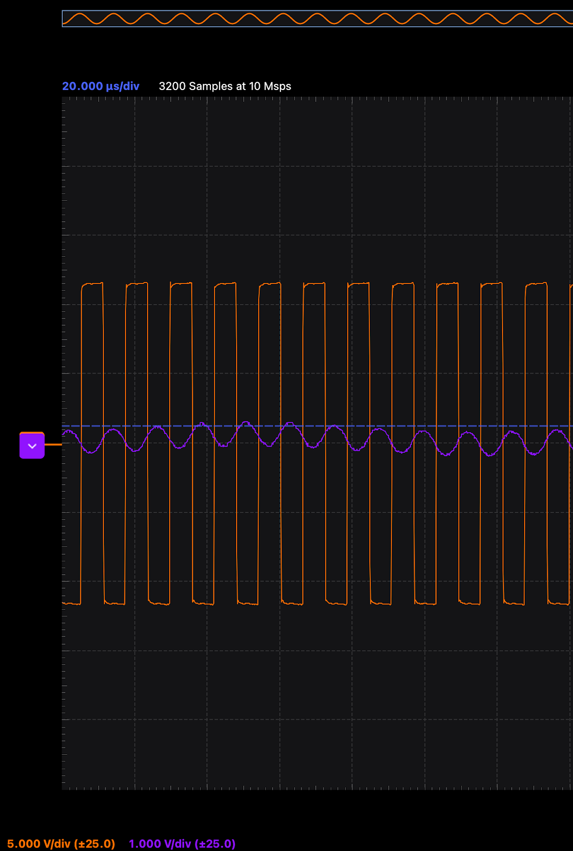
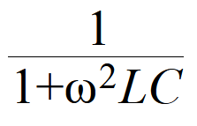
Schematic Part 4
High power digital signal needs to be converted back to analog
The filter acts like a low pass filter with a transfer function of
When the +width and -width are equal, the output voltage is mostly stable around 0v
E F

Slide 8
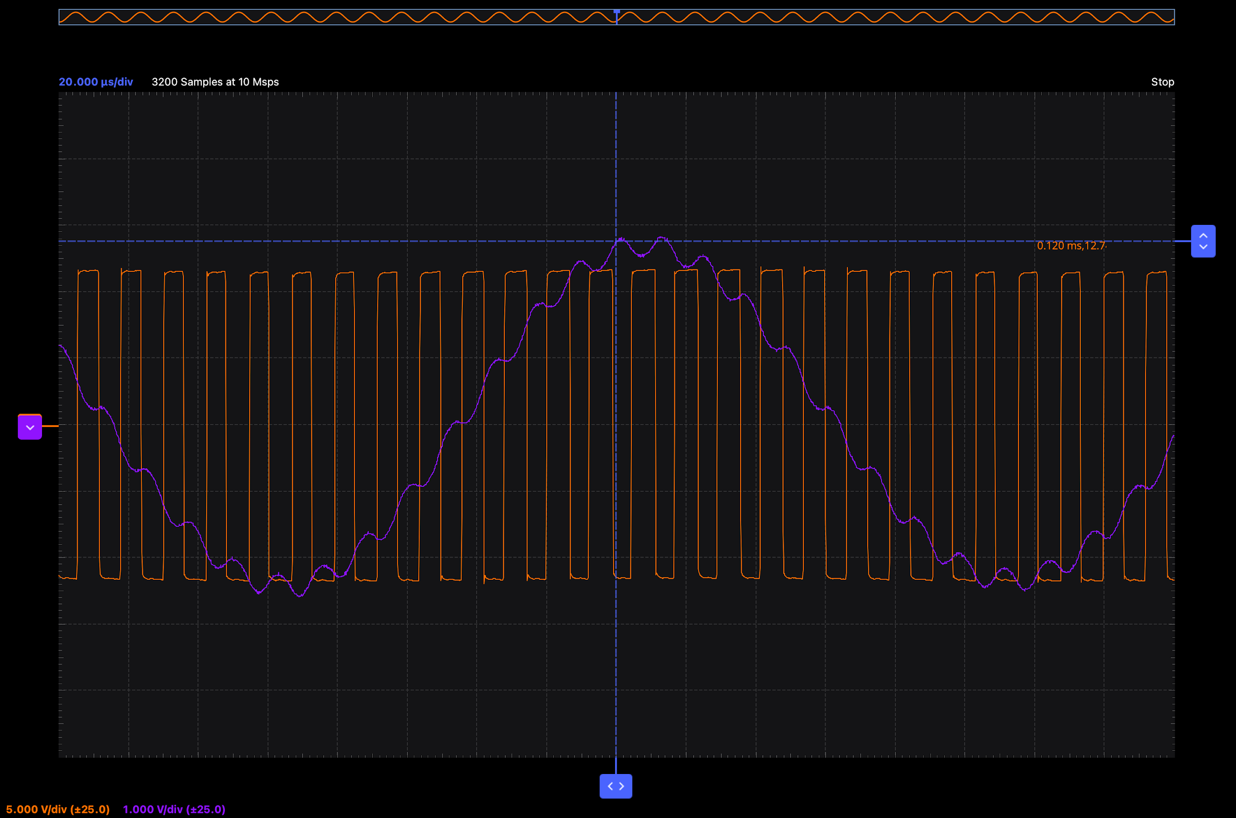
The Magic
The really cool part is when the pulse width is modified by an audio signal
The circuit functions like a buck converted (voltage regulator), where the setpoint voltage is the voltage of an audio signal
The modulation can faithfully reproduce frequencies up to ≈1/10 of the switching frequency

Slide 9
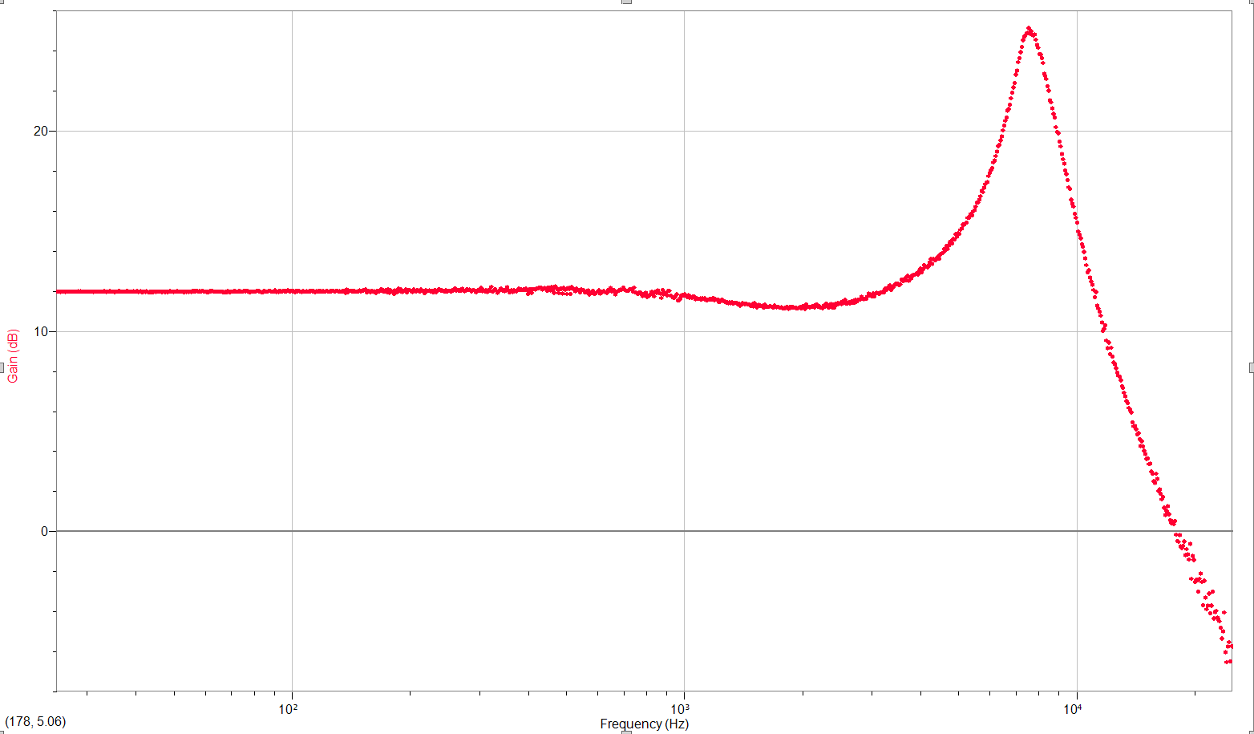
Operation
Because the inductor is kept in continuous conduction by design, the output barely changes when a load is introduced
The output power limit is imposed by the input power supply; with more power available it could reach higher power levels
The gain-frequency graph shows that the gain almost perfectly stable until 2.5 kHz
The gain drops off drastically after 10 kHz which is inline with the rule of thumb considering the switching frequency of 85 kHz

Slide 10
Improvements/Add-ons
The project was completed to my initial expectations, although more input power would be a welcome addition
Lower the noise floor (hissing caused by stray signals)
Increase switching frequency for better reproduction of high frequencies
Add an internal regulator to remove the need for two power supplies
Add a heatsink to the transistors for even more power capability (in combination with the first point)
Build another! (for stereo speakers)

Slide 11
Demo

